Slide 1



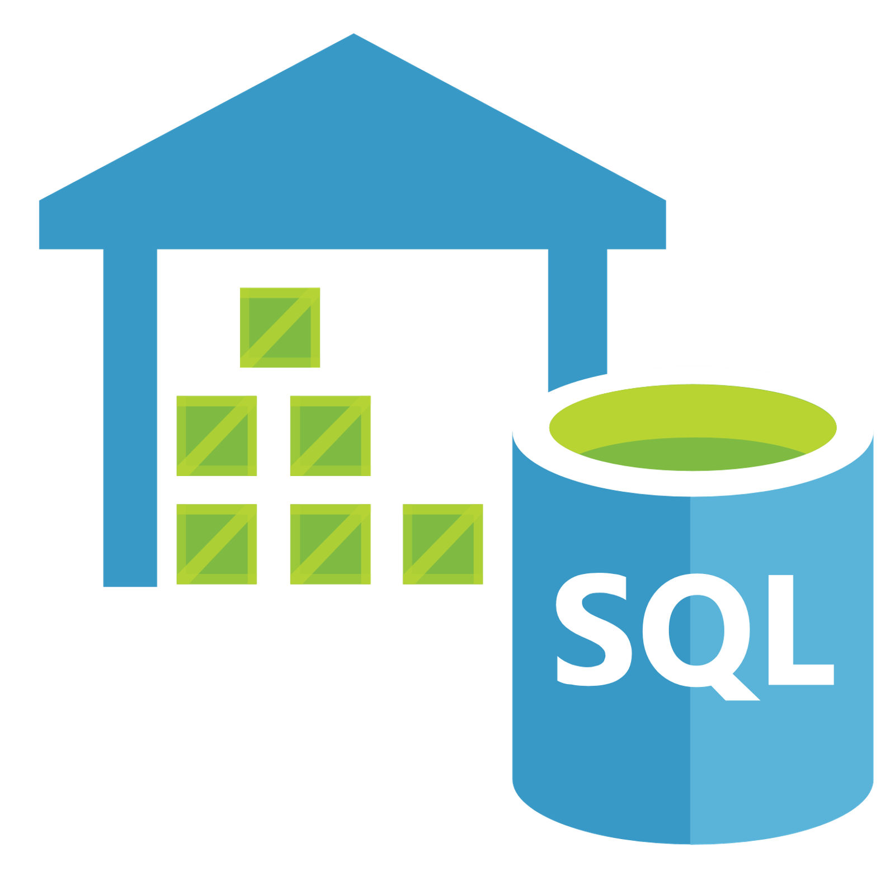



Data Factory Orchestration
Power BI Data Presentation
Data Bricks Data Preparation
SQL Data Warehouse Database Service
Event Hub Event Service
Virtual Machine Database Service
Analysis Services Analytics
Azure Database Database Service
Virtual Machine Database Service

Slide 2

Virtual Machine Database Service
Virtual Machine Compute

Slide 3

SQL Database Database Service
SQL Data Warehouse Database Service
SQL Server Logic Server

Slide 4

Resource Group Collection

Slide 5




Key Vault Secret Management
Managed Identity Service Authentication
Azure Active Directory Identity Service
Subscription TalkTalk Plc

Slide 6


Event Grid Automation
Logic App Automation

Slide 7




Storage Explorer Resource Management
Blob Storage
Data Lake Storage
Storage Account Storage

Slide 8




Network Security Group Networking Service
Virtual Network Networking Service
Azure Firewall Networking Service
Firewalls & Virtual Networks TalkTalk Networks
Azure Trusted Services
Azure Network Peering

